Slide 1
Baklava
A math-driven tower defense game

Slide 2
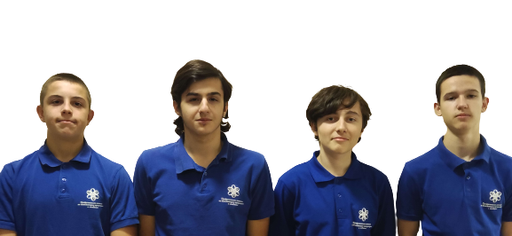
Baklava
A math-driven tower defense game
Our Team
Ivan Stoychev
- Back-end Dev
Stoyan Ivanov
- Front-end Dev
Stoyan Skuliev
- Scrum Trainer
Ivelin Bozhilov
- QA Engineer
1

Slide 3
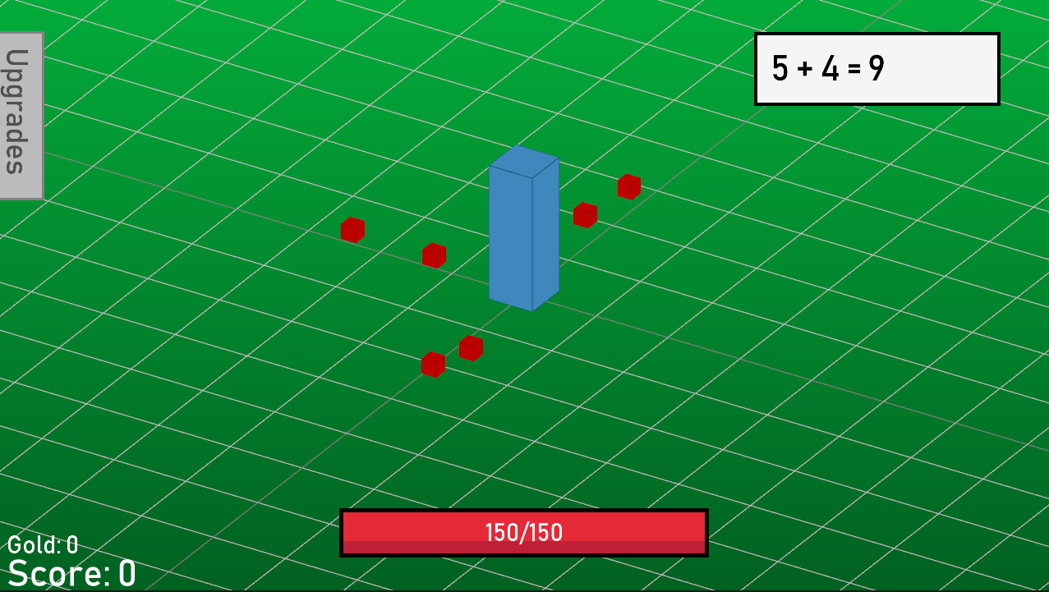
Our Team
Ivan Stoychev
- Back-end Dev
Stoyan Ivanov
- Front-end Dev
Stoyan Skuliev
- Scrum Trainer
Ivelin Bozhilov
- QA Engineer
1
Our Idea
Our idea was to incorporate solving math equations into a tower defense game in a fun and relatively balanced way.
2

Slide 4













Our Idea
Our idea was to incorporate solving math equations into a tower defense game in a fun and relatively balanced way.
2
Used Tech
3

Slide 5
Used Tech
3
Thank you for your attention!
Let us continue to the project.

